Slide 1
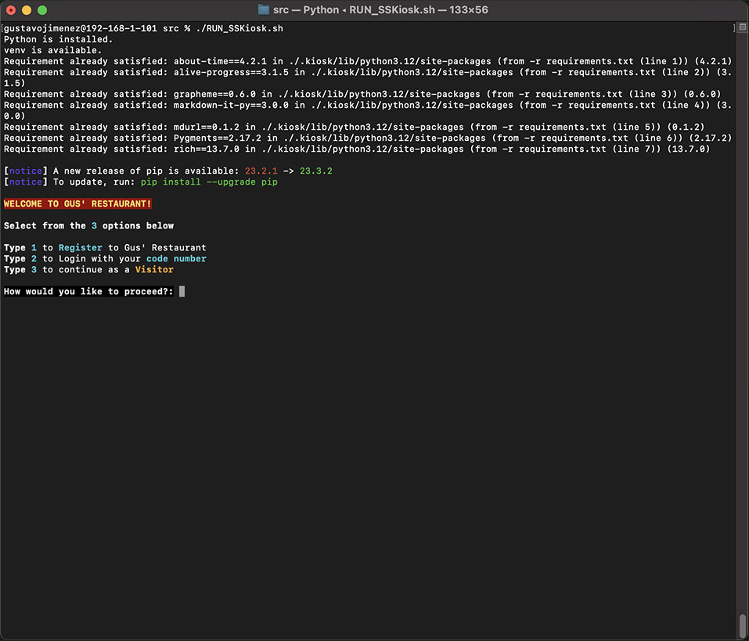
R9 An overview of your Terminal application
Main features and overall structure of your app
I’ve chosen a Self Service Kiosk, for my App.
Besides an everyday SS Kiosk, this one also has a user registration which takes the user information to track consumption and offer discounts and gifts.
When initialising the ./RUN_SSKiosk.sh
There is an if statement checking if python and virtual environments are available. Also, it will install the requirements.txt, among them rich, which helped on the look of the application
rich==13.7.0
The app offers 3 options, Register, login, and visitor.
Starting with option 1, For users that are frequent visitors, and are interested in being part of the of the perks offered
Option 2, if for previously registered users to have full access to the functionality offers and discounts
Option 3, the user has the basic functionality of the app, for a quick once in a while visit and order

Slide 2
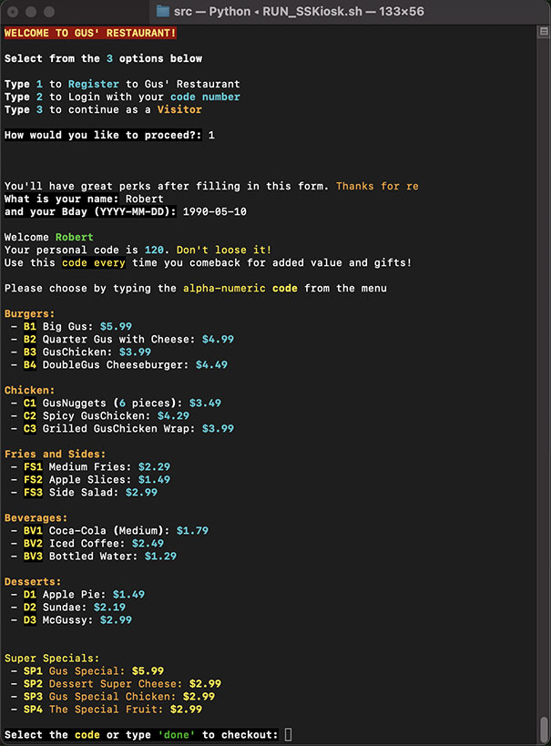
R9 An overview of your Terminal application
Main features and overall structure of your app
Option 1 and menu
Proceeding with option 1, the user provides name and birthday data. From the existent user-database the program will save the information and will generate personal database and the code for “Robert” to login
As a registered user, Robert would have access to the extra offerings the restaurant has. See image with red square

Slide 3
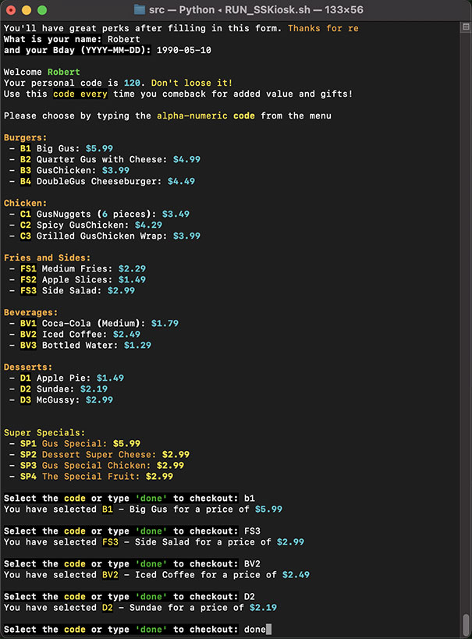
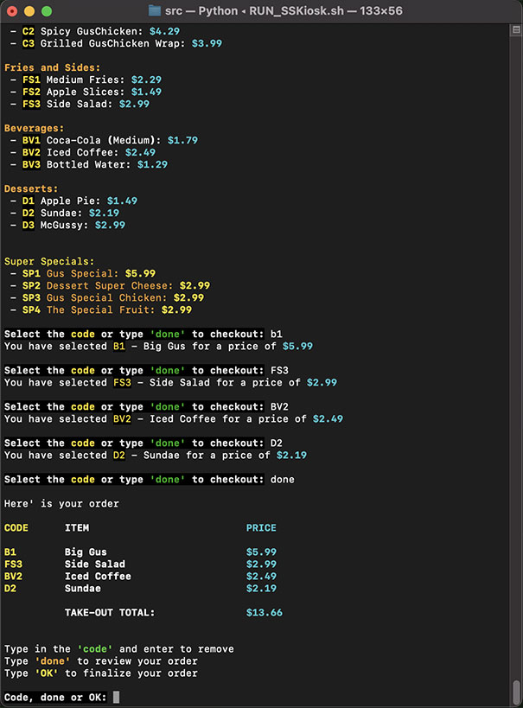
R9 An overview of your Terminal application
Main features and overall structure of your app
menu order
Here in the menu section the user only has to select the desire item by typing the code in yellow. The user selection is kept in a temporary list until the user has typed “done”, this action then will create the order in a separate json file.
After the user has added the items from the menu, a summary of the order is shown for the user to confirm or remove unwanted items.

Slide 4
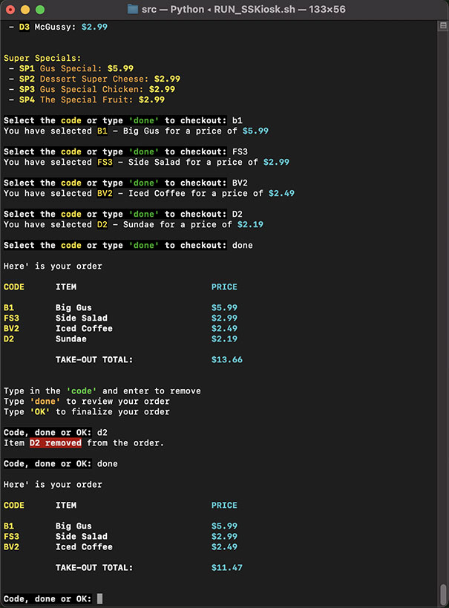
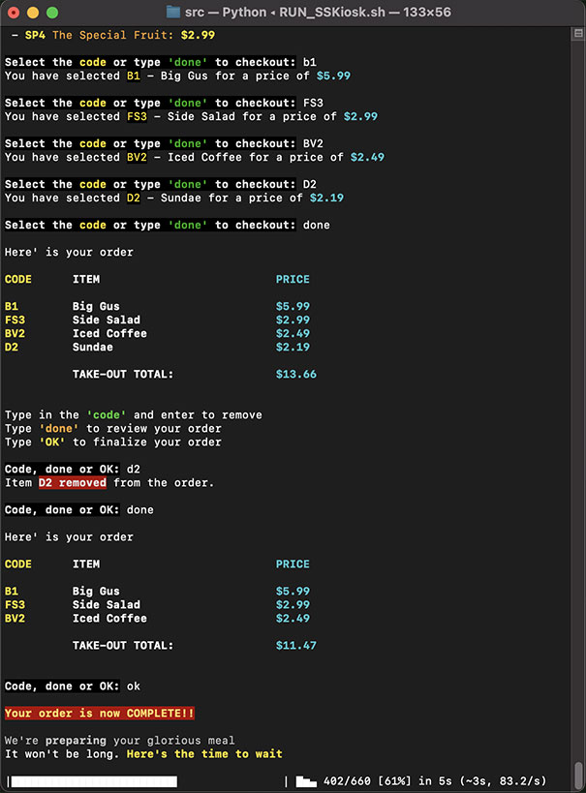
R9 An overview of your Terminal application
Main features and overall structure of your app
menu order - confirmation
The first image shows that an item, D2 has been removed from the order and and a new order summary is displayed after the user has type “done” once again.
In the second image the user has finally OK’ed the order. A Message of showing the order is now being prepared plus a time to wait is displayed.

Slide 5
R9 An overview of your Terminal application
Main features and overall structure of your app
menu order - confirmation
The first image shows that an item, D2 has been removed from the order and and a new order summary is displayed after the user has type “done” once again.
In the second image the user has finally OK’ed the order. A Message of showing the order is now being prepared plus a time to wait is displayed.

Slide 6
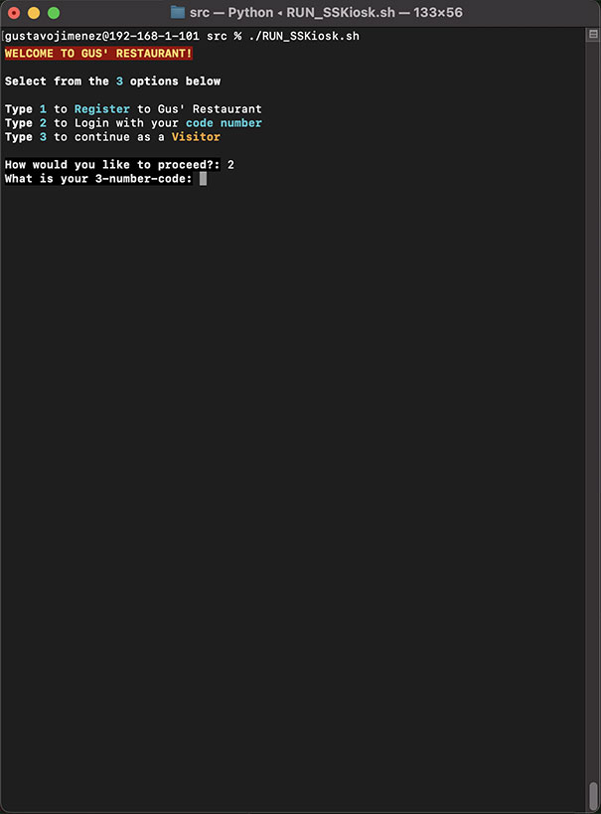
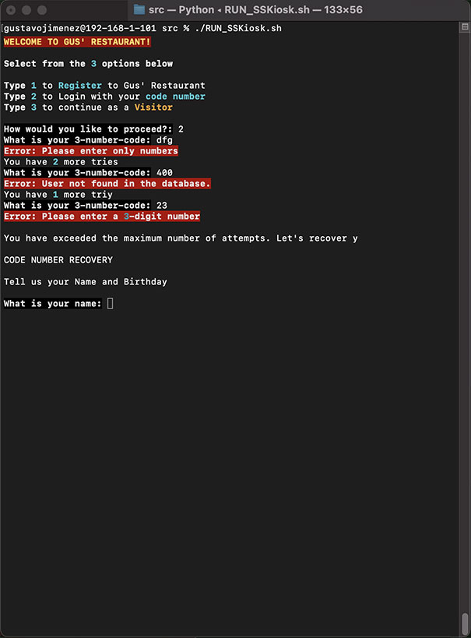
R9 An overview of your Terminal application
Main features and overall structure of your app
User login fail and recovery
Looking at option 2, user login
After having registered a 3 number code is issue for the user to login.
If the user remembers the code no issues arises, it will be taken to the menu as in the previous purchase process.
In this case, image 2 shows a user who tried to logging but failed to input the code correctly or forgot it.
The program then continues to ask for name and birthday

Slide 7
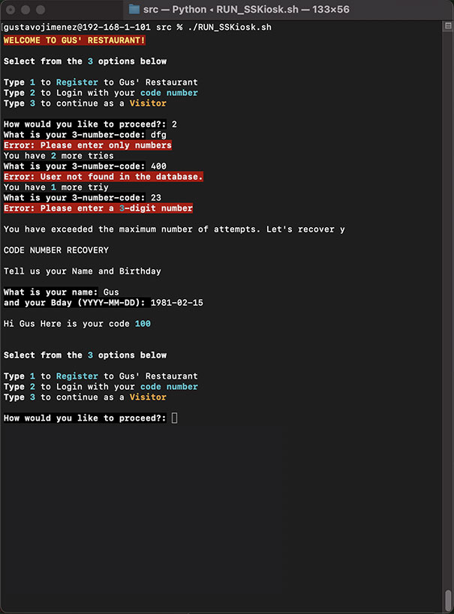
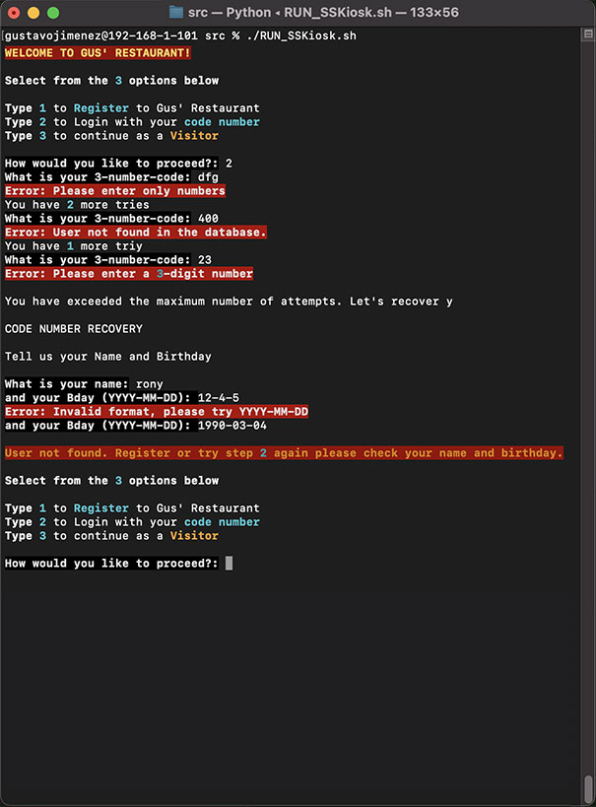
R9 An overview of your Terminal application
Main features and overall structure of your app
User login fail and recovery
Image 1 shows a user who had registered and existed in the database, this user input the name and the birthday correctly
Image 2 shows a user who didn’t input the required information correctly or does not exists in the database.
In this case the program will return to the initial stage to ask for the steps again

Slide 8
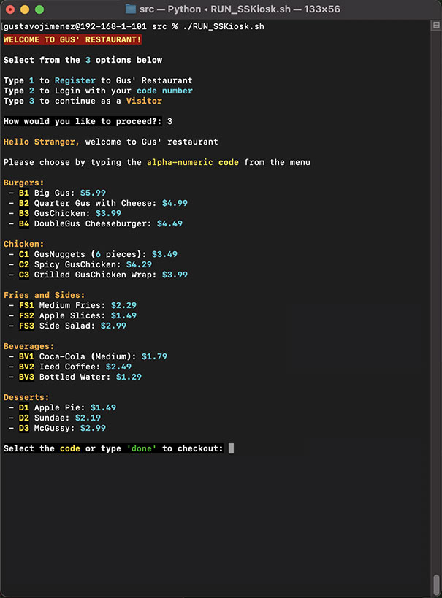
R9 Overview of The Terminal Application
Main features and overall structure of your app
User option 3 - visitor
Option 3 of allows a visitor to access the kiosk quickly and privately. A user who doesn’t need or is interested in an account.
By typing 3, a basic menu will display, following the same functionality as shown previously with the difference that the special offers are not shown. Also, a temporary database is created and deleted for these scenarios

Slide 9
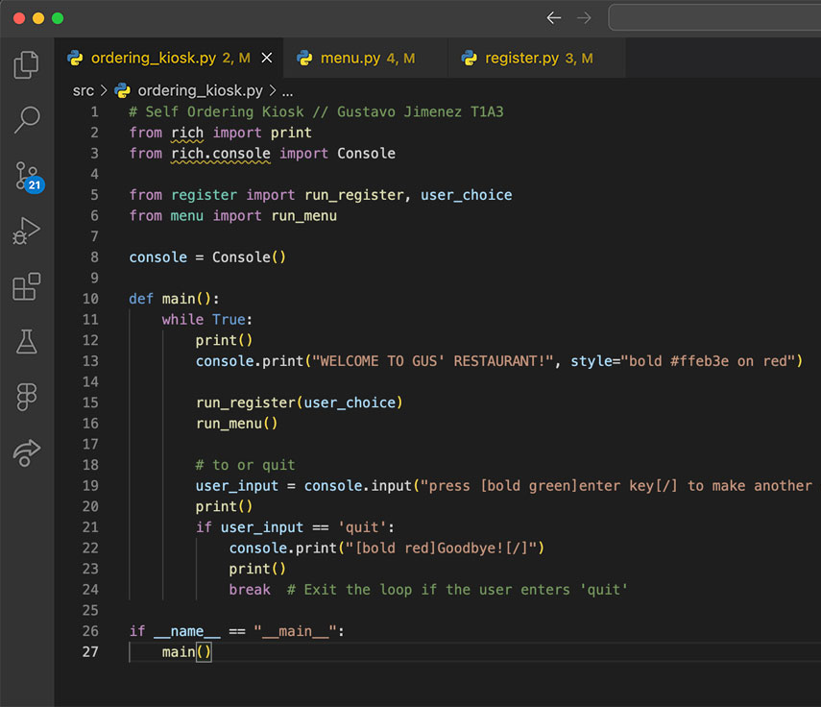
R10 Overview of The Code
Important parts of the code, including any crucial application logic
ordering_kiosk.py - main page
main() function prints welcome message.
Runs register.py
Runs menu.py
Finally, when the user has register and/or made an order, a continue or quit message will be displayed.
While a real life kiosk would not allow user to quit the program, here it is implemented for app requirements

Slide 10
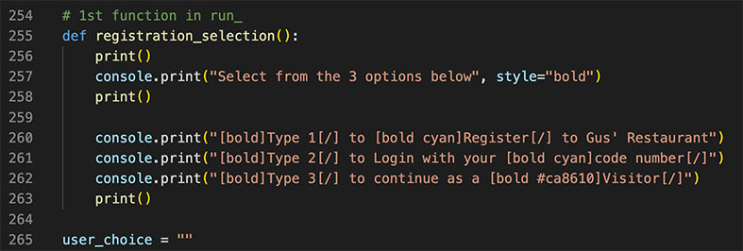
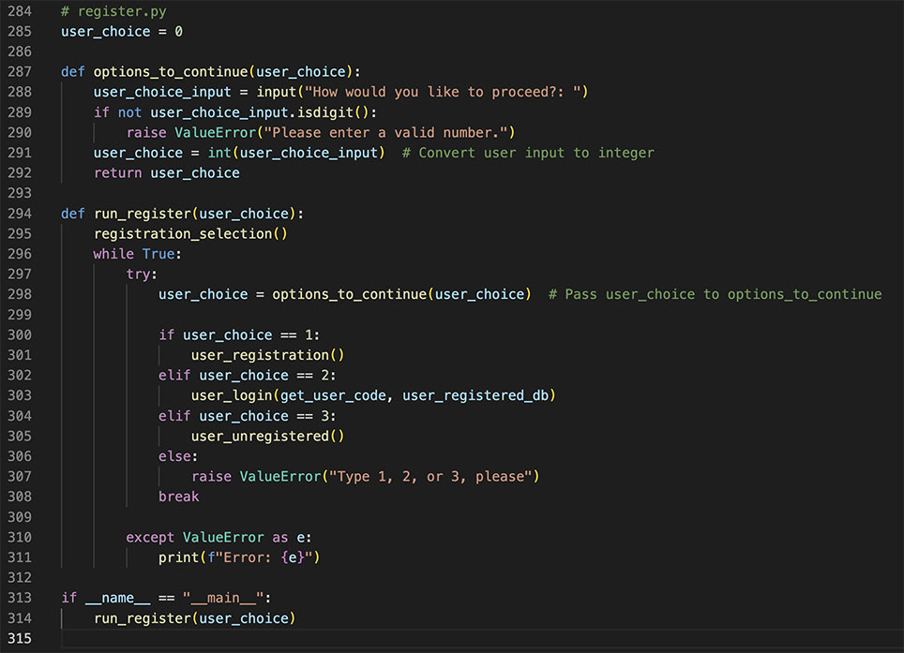
R10 Overview of The Code
Important parts of the code, including any crucial application logic
register.py
Registration: page uses a main function which will call in the function needed depending on the user input.
Each of the 3 options calls a function, while also checking for bad inputs; numbers different from 1, 2, 3, and letters

Slide 11
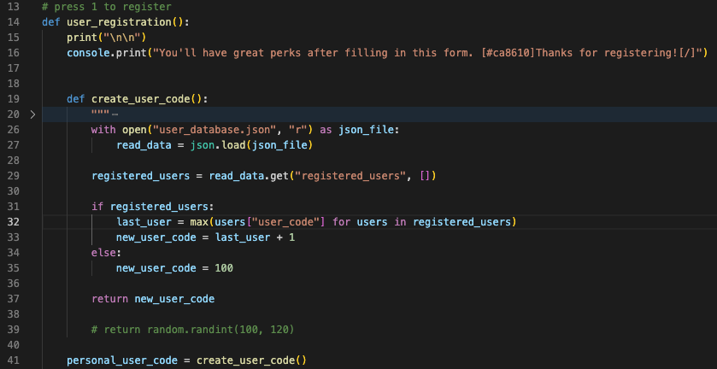
R10 Overview of The Code
Important parts of the code, including any crucial application logic
Option 1 user register
User input 1, activates user_registration()
create_user_code() function reads an existent user_database to return a 3 number code, this code is created in succession from the last one created
create_user_code() is stored in personal_user_code

Slide 12
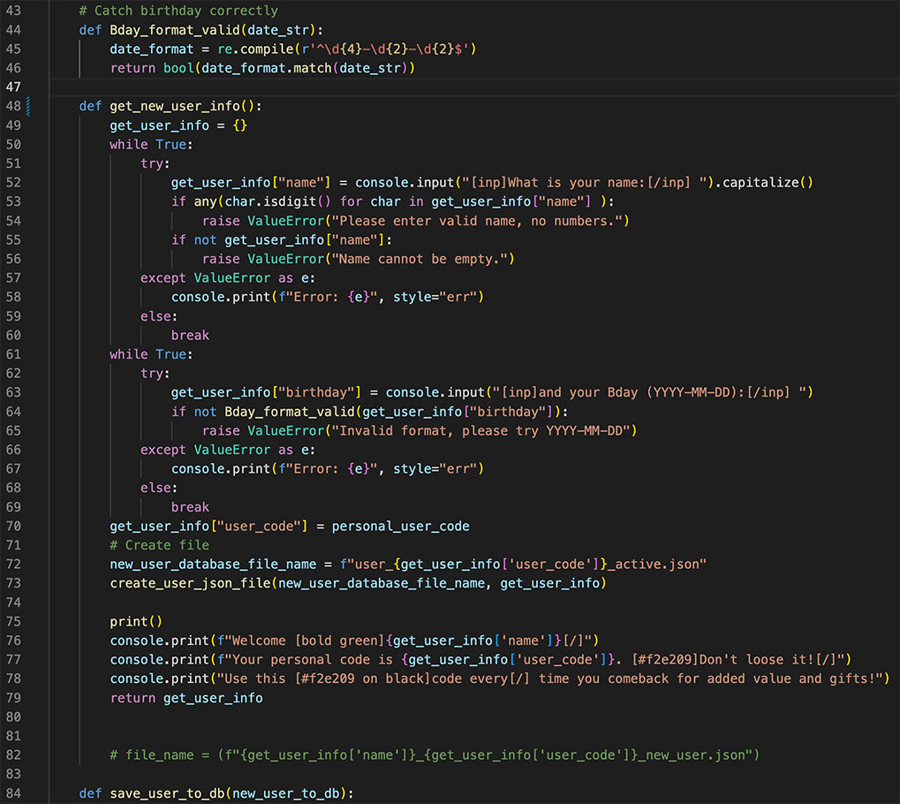
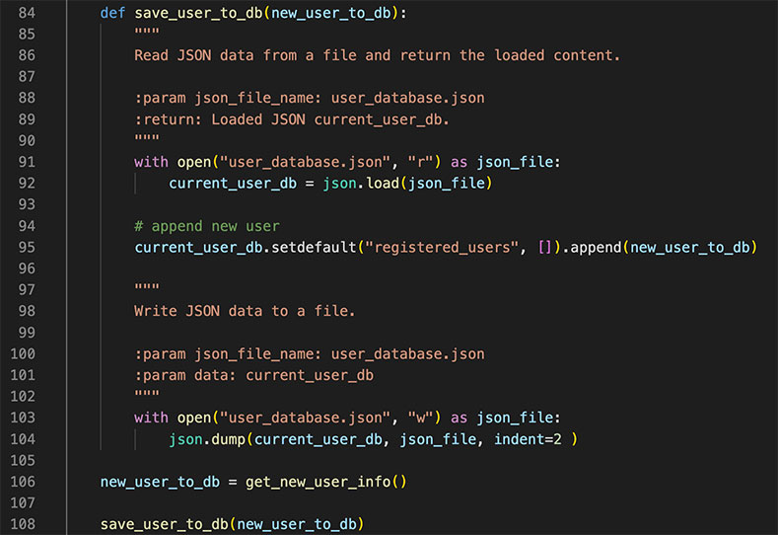
R10 Overview of The Code
Important parts of the code, including any crucial application logic
Option 1 user register
User input 1, activates user_registration()
get_new_user_info() will ask for name and birthday while tracking error. There’s a function to catch that the format of the birthday is also correct
A new dictionary is created with name, birthday and the code generated from the previous create_user_code()
Also, a new user specific database is created
A welcoming message is printed for the user to continue to menu ordering
get_new_user_info() new data created gets stored in new_user_to_db
Which save_user_to_db(new_user_to_db) function will use to append to the current database

Slide 13
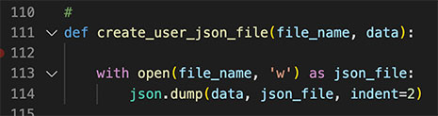
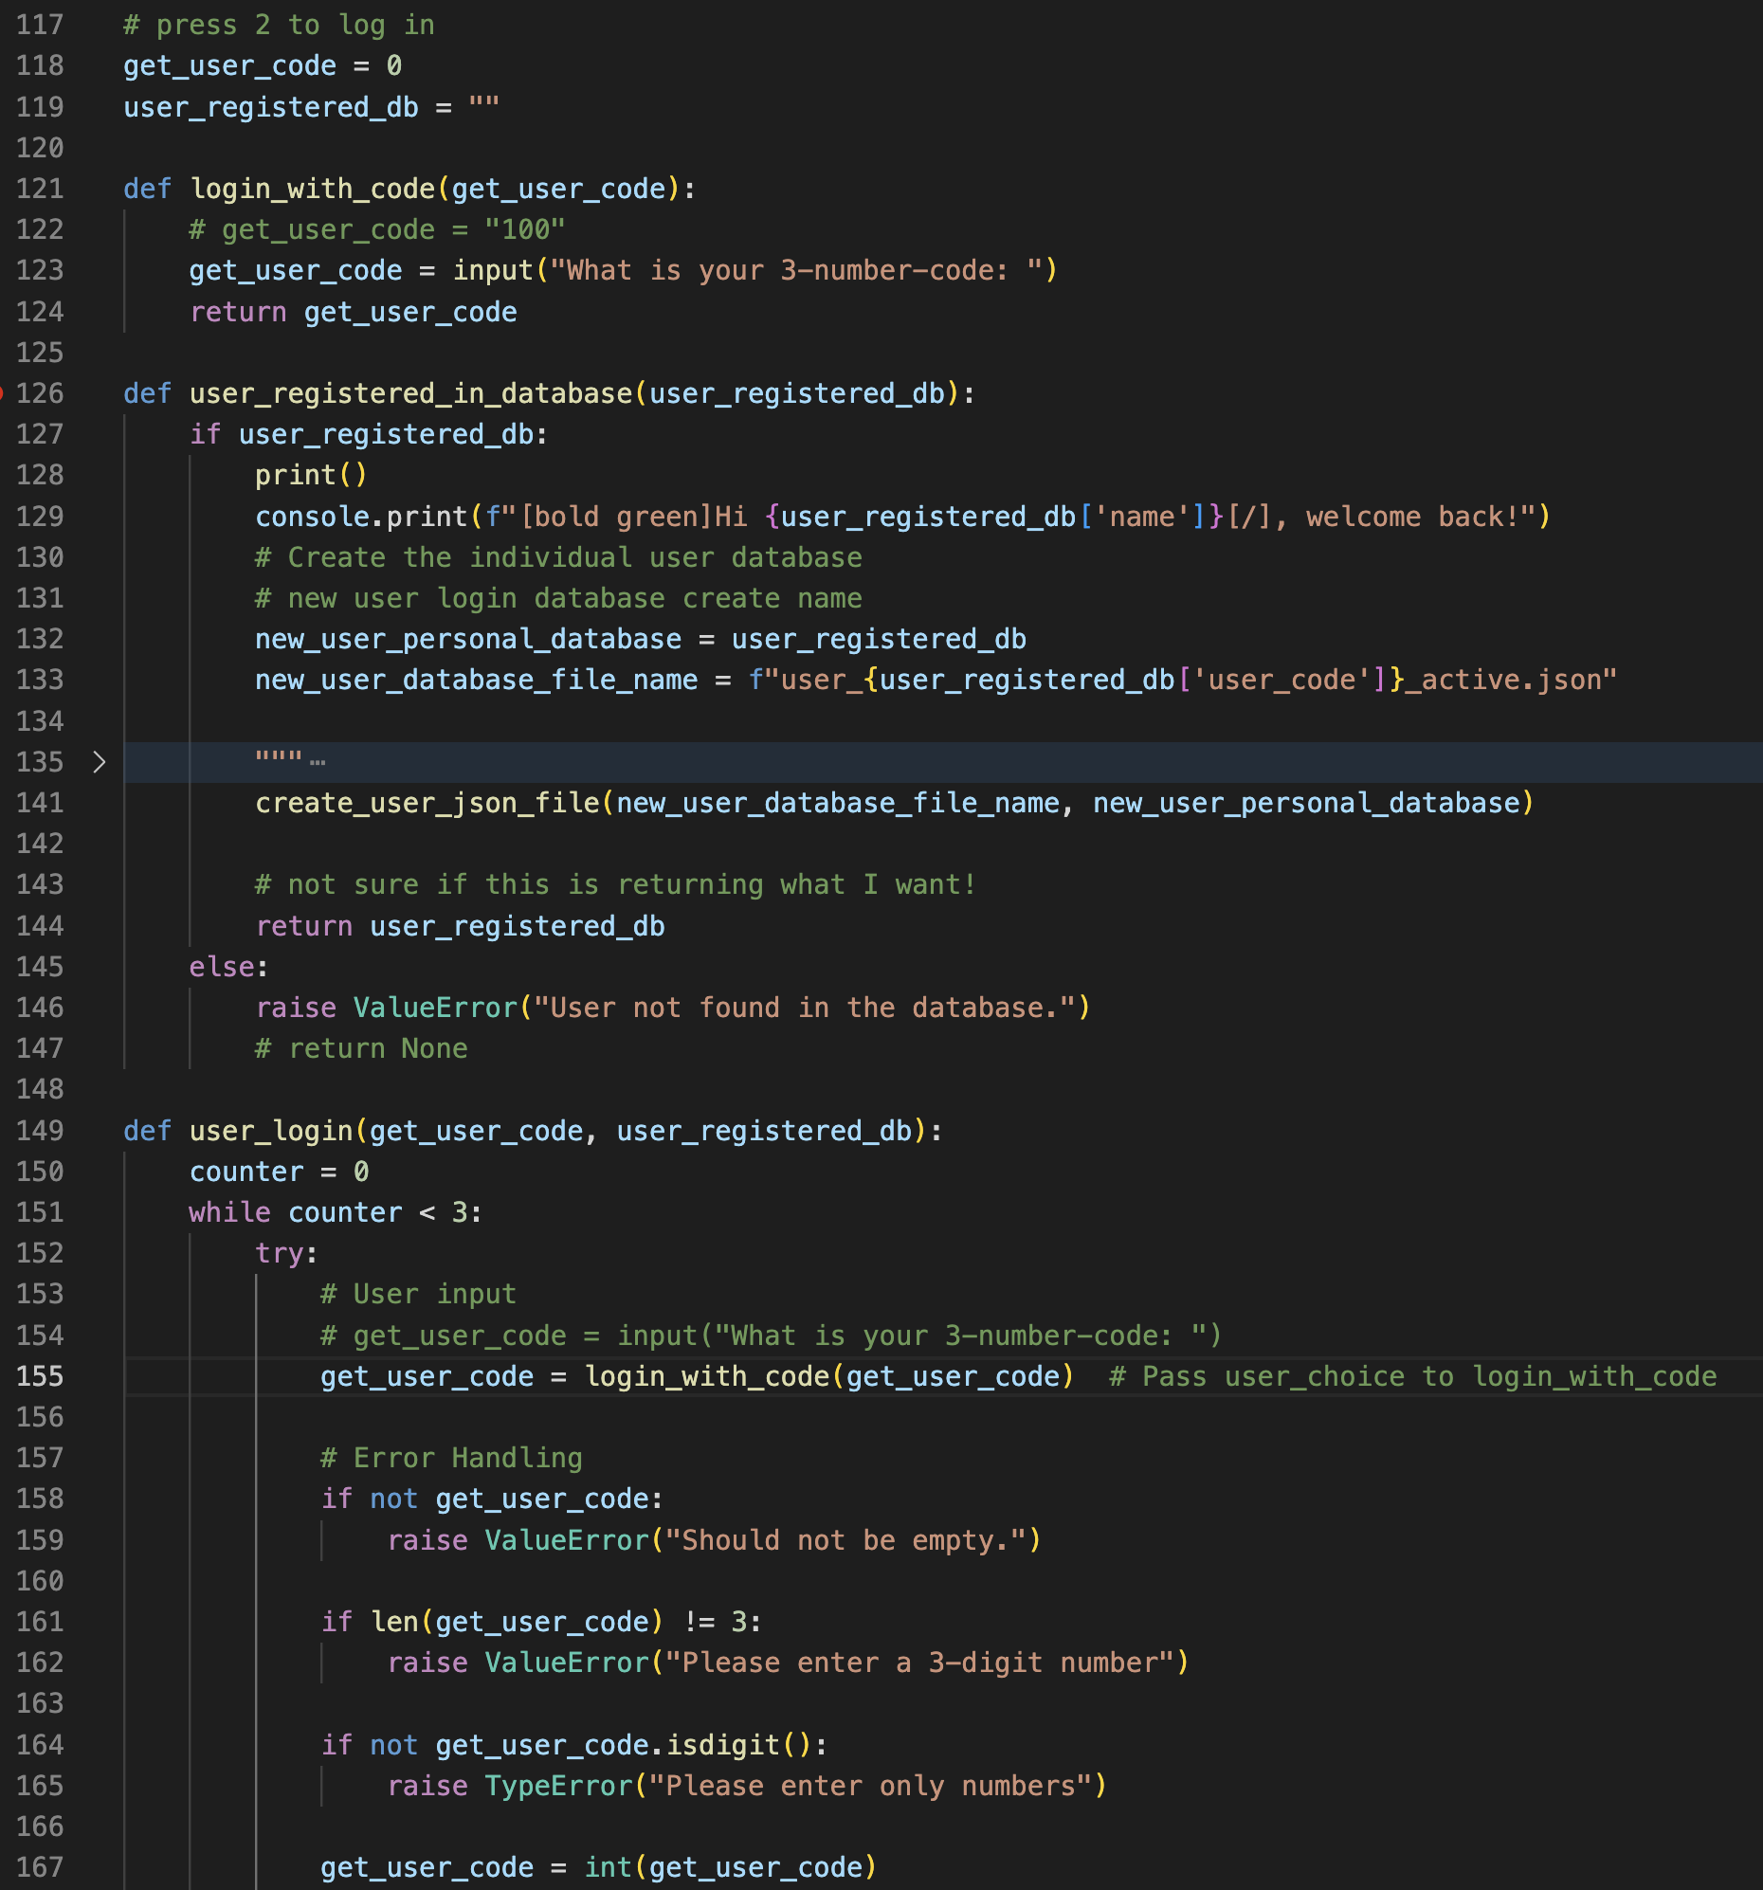
R10 Overview of The Code
Important parts of the code, including any crucial application logic
Option 2 login
User input 2, activates user_login()
A while function with a counter checks for the user to input an existent user_code; the counter will check for failed 3 tries to take the user to recover the lost code.
If the user input the correct code this will be converted into integers to be match against the data in user_database.json
Finally when the match is done user_register_db a welcome back message and creates or accesses a json file for the user
create_user_json_file is in charge of this task

Slide 14
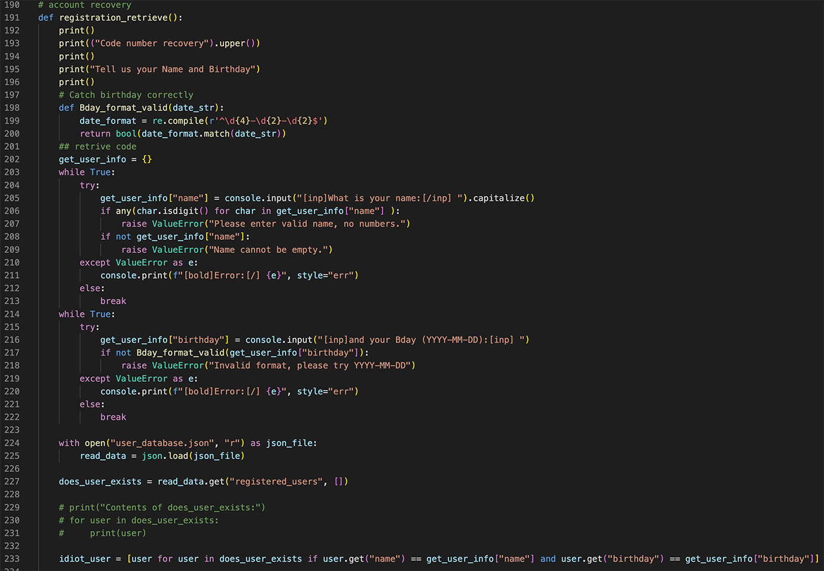
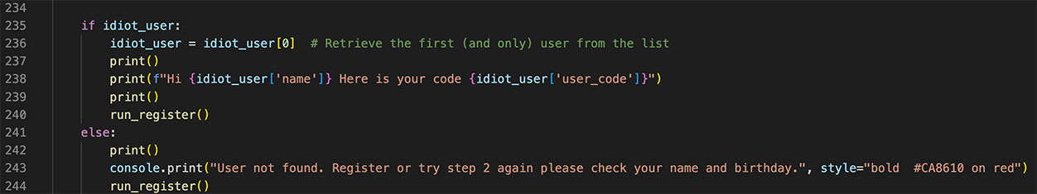
R10 Overview of The Code
Important parts of the code, including any crucial application logic
Option 2 login - Failed
User input 2,
If the counter in user_login() is exhausted. registration_retrieve() is called for the user to input personal details and get his code
If details are successful the code would display and the user can now login.
If the wrong details or details don’t match the database. The user will be sent back to the initial 3 steps and be asked if wants to re-try personal details or continue with step 1 or 3

Slide 15
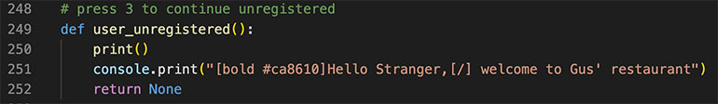
R10 Overview of The Code
Important parts of the code, including any crucial application logic
Option 3 visitor
User input 3,
This function simply prints a message and returns None for continuing to menu page

Slide 16
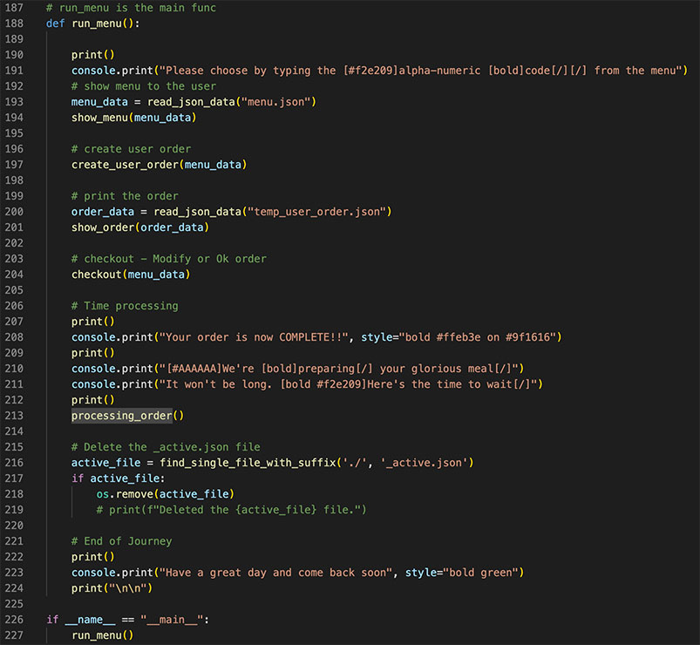
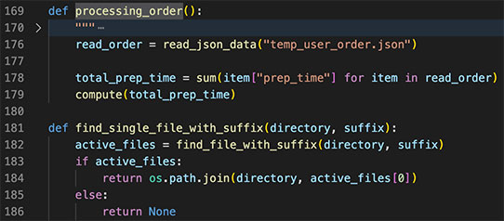
R10 Overview of The Code
Important parts of the code, including any crucial application logic
Menu.py - run_menu()
This function is in charge of organising the flow of the transaction, so it calls functions accordingly
The flow is basically
menu_data: Read menu database
show_menu: Display menu
create_user_order: a database store the user inputs
order_data: reads the above order
show_order(): Displays the summary of the order
checkout(): Order can be modified or to continue purchase
Purchase of positive feedback message display
processing_order() displays the time of preparation
If a file for a registered user was activated/created in this instance, that files is deactivated/removed
Come back message is displayed section ends
The flow goes back to ordering_kiosk.py(main page) to continue or quit

Slide 17
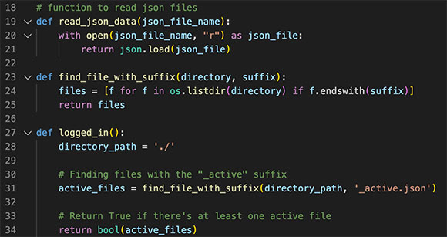
R10 Overview of The Code
Important parts of the code, including any crucial application logic
Menu.py - users
A function to read json files and keep the code DRYer
find_file_with_suffix() and logged_in()
Are functions used to detect the json file created for the user that registered or logged in previously in register.py

Slide 18
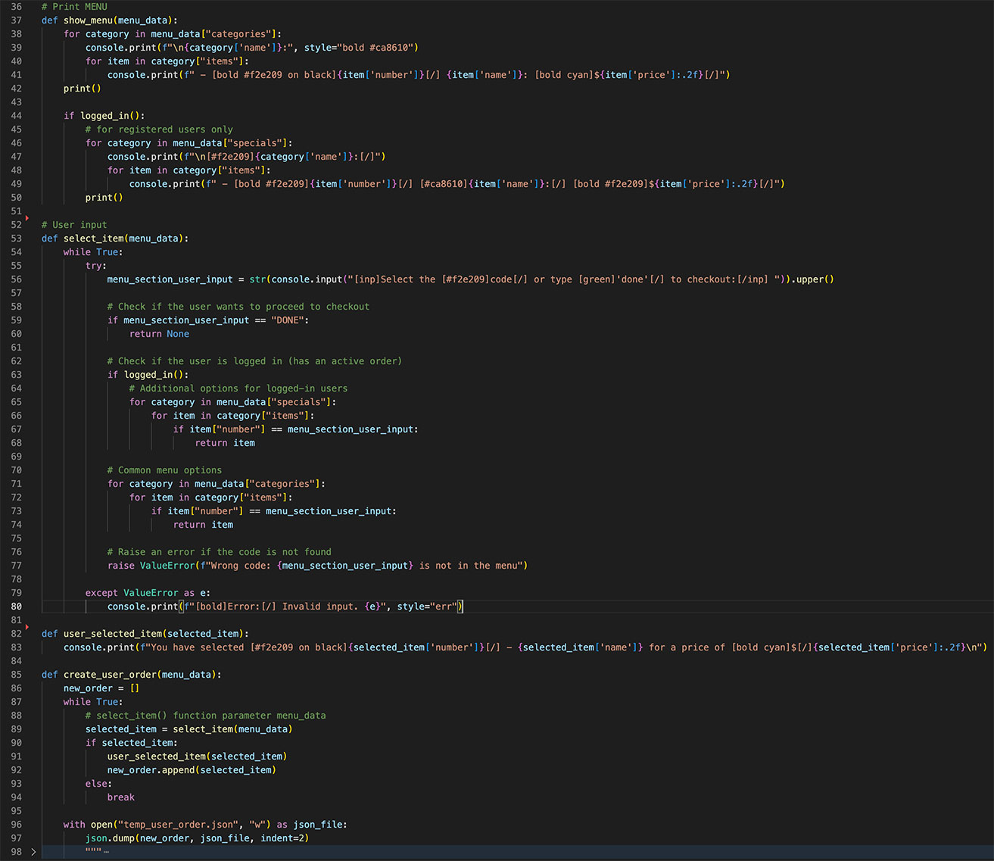
R10 Overview of The Code
Important parts of the code, including any crucial application logic
Menu.py - display
A function to read json files and keep the code DRYer
find_file_with_suffix() and logged_in()
Are functions used to detect the json file created for the user that registered or logged in previously in register.py

Slide 19
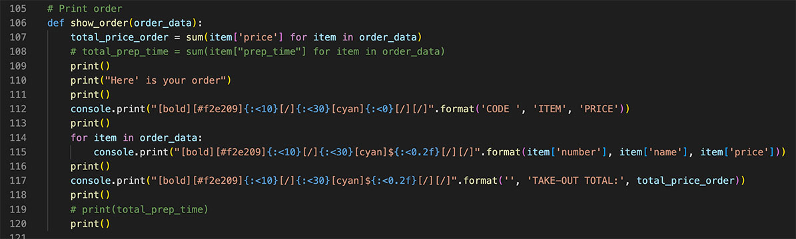
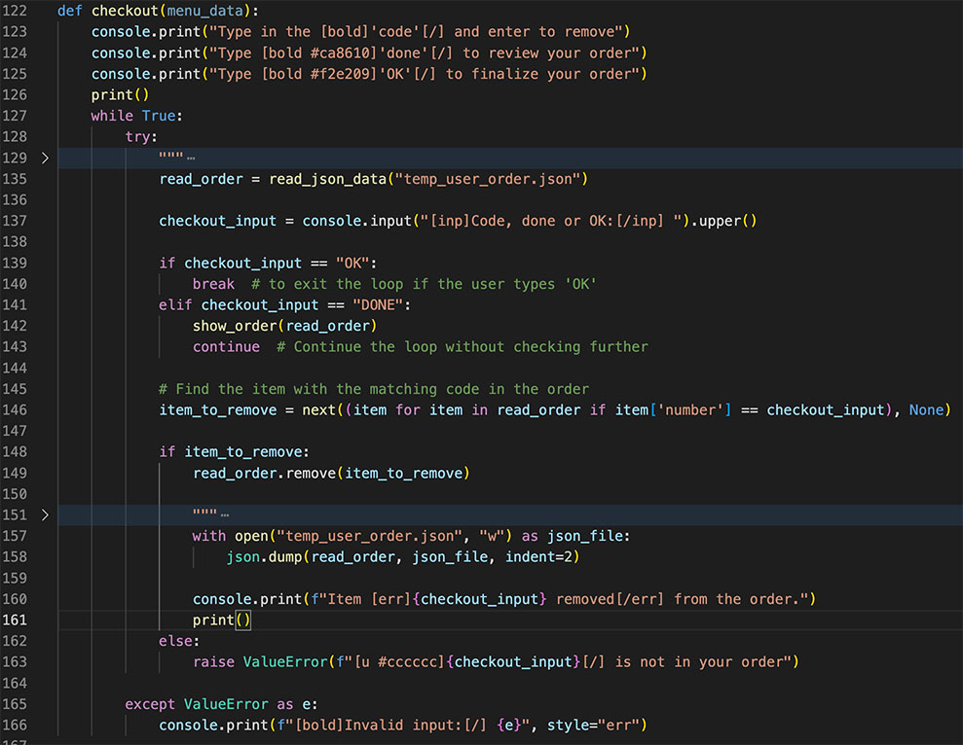
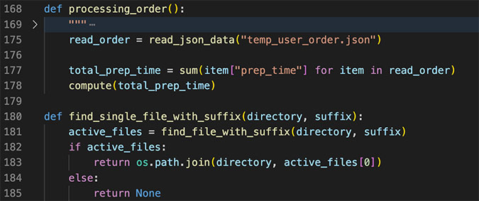
R10 Overview of The Code
Important parts of the code, including any crucial application logic
Menu.py - show summary order
show_order() summarises the items from the menu that the user selected
checkout() allows the user to modify the order and OK it
processing_order() reads the final order adds up the cooking time of each item and presents a progress bar indicating the time to wait. It’s not real time, it’s about a sixth of the actual time.

Slide 20
R10 Overview of The Code
Important parts of the code, including any crucial application logic
Menu.py - review of run_menu()
After the user’s order has been complete and the time has also elapsed. The program will continue to line 216.
As explained before:
“If a file for a registered user was activated/created in this instance, that files is deactivated/removed
Come back message is displayed section ends
The flow goes back to ordering_kiosk.py(main page) to continue or quit”

Slide 21
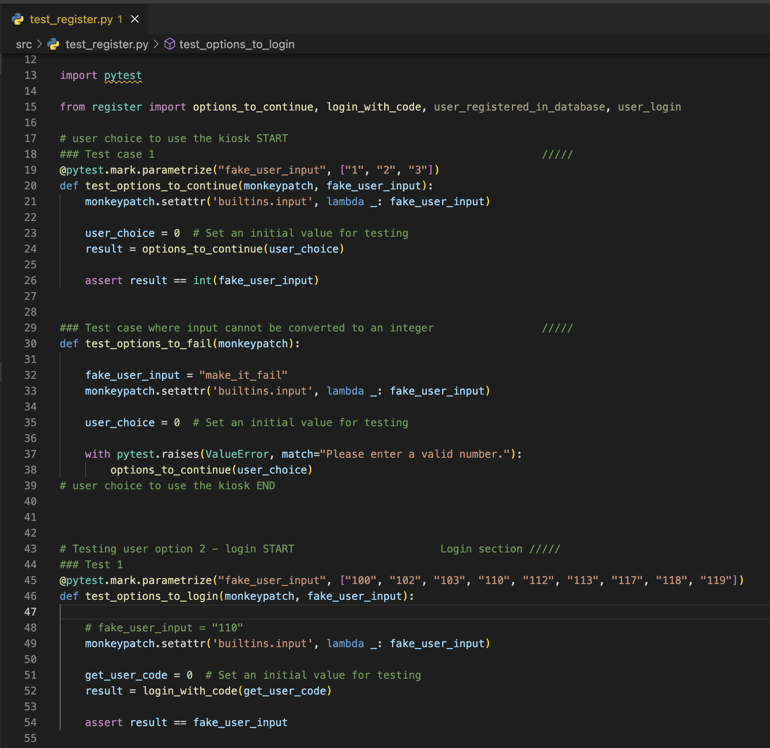
R10 Overview of The Code
Register page automated test
Testing user options inputs
Line 19 is to test the initial step for the user to user the Kiosk.
It tests for 1, 2, 3, which correspond to register, login, visitor
For the same section, line 30 test for bad inputs from the user
Line 45 tests for the login section, several existing codes in user_database.json are tested here

Slide 22
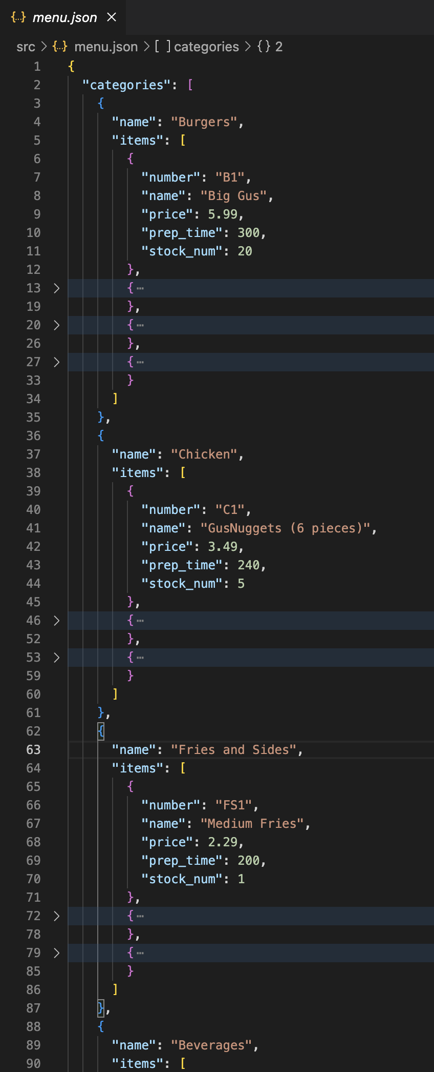
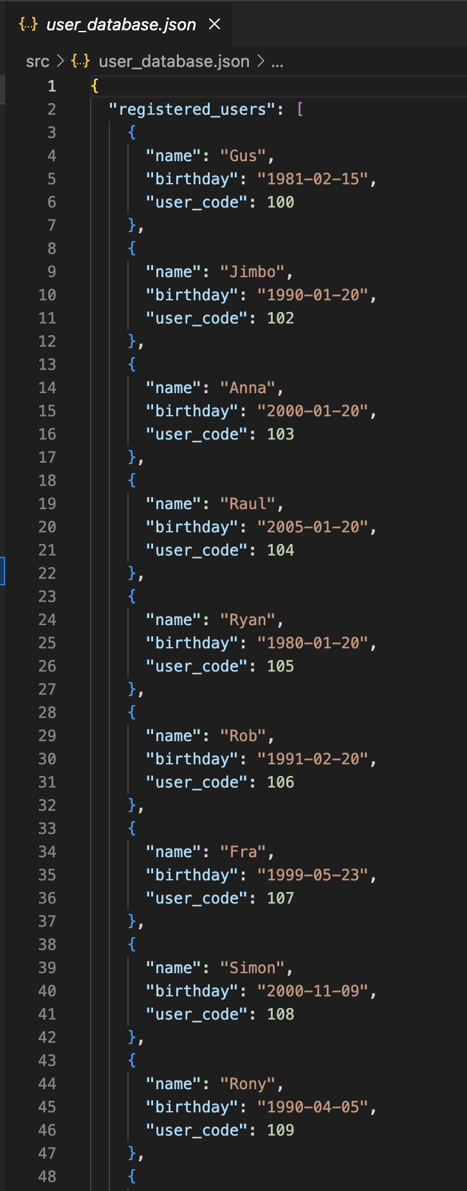
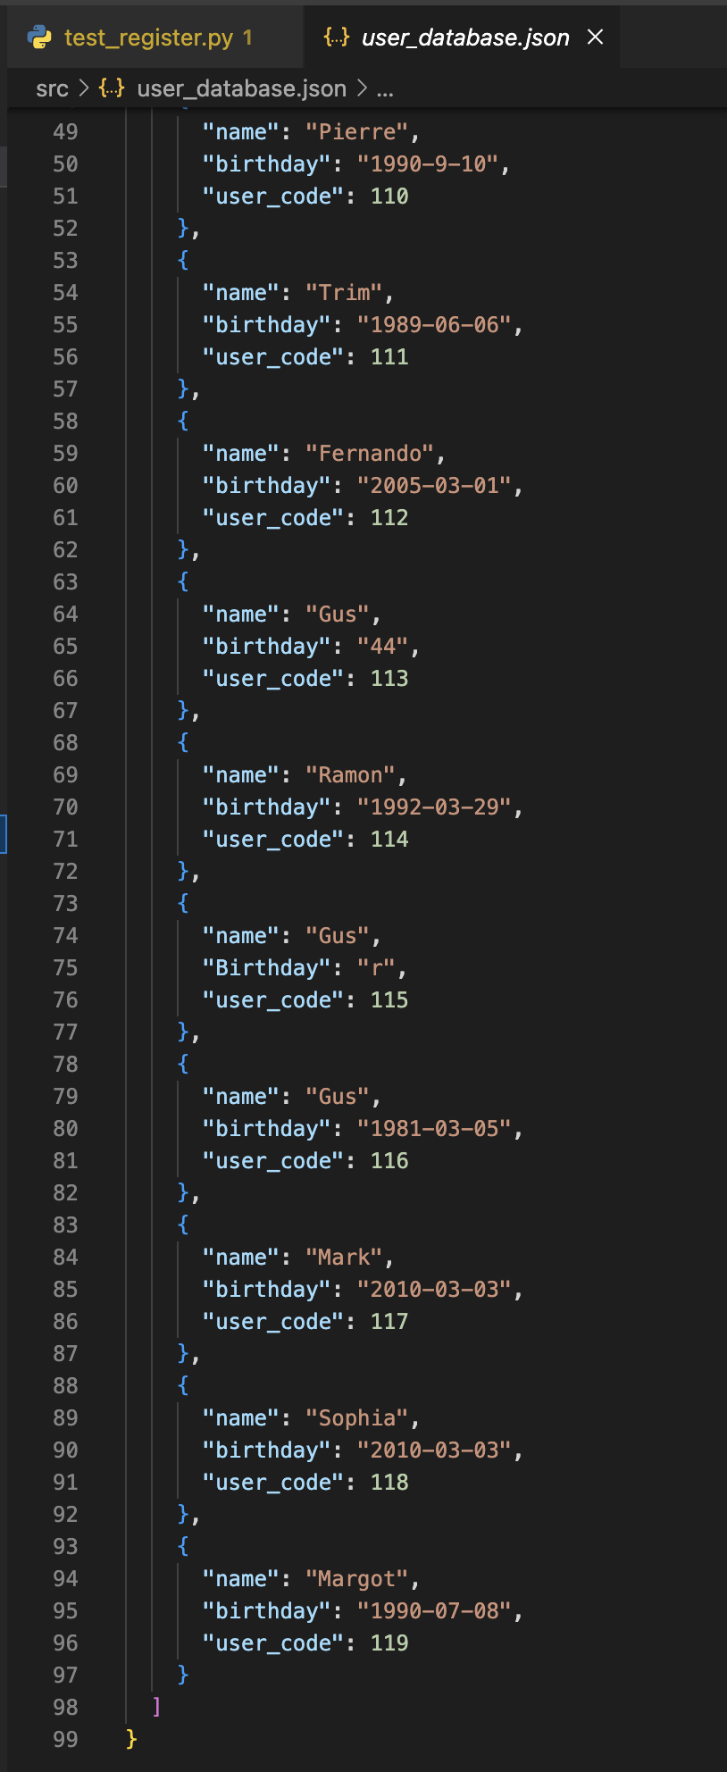
R10 Overview of The Code
Json databases
databases
Menu.json and user_database.json are permanent databases that the program will use.
As mentioned before when a new user registers a personal database is created, that is to keep track of consumption patterns and birthdays and discounts

Slide 23
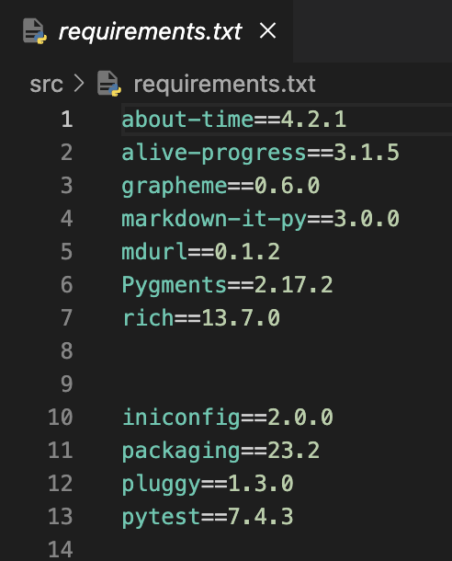
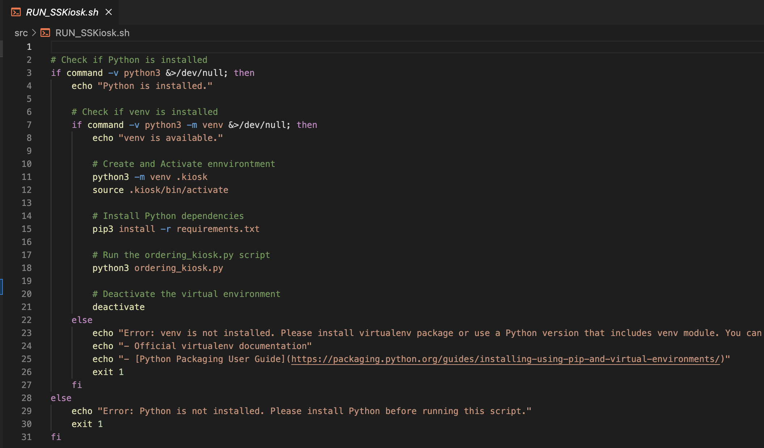
R10 Overview of The Code
Libraries or other code part of the build
Executable file
RUN_SSKiosk.sh has prebuilt commands to help running the entire app
And if statement checks for python to be installed it also checks for a virtual environment.
If not problems it continues to create the venv, install requirements and finally run the the main kiosk file
The the user quits the venv is deactivated
When the if statement is not satisfied, instructions on how to solve the problem are displayed
Requirements.txt are the libraries to be installed

Slide 24
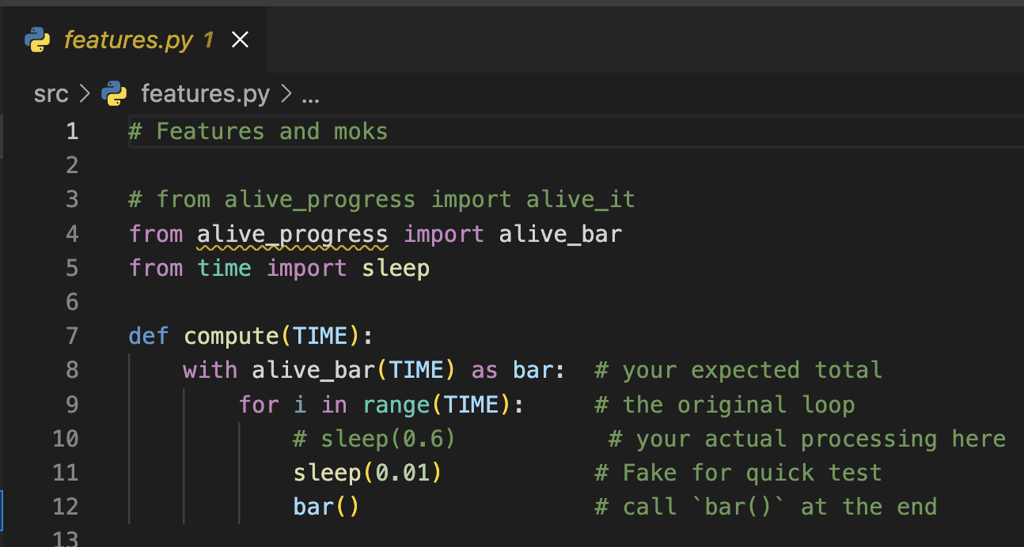
R10 Overview of The Code
Libraries or other code part of the build
features.py
A simple file to setup the progress bar that shows when the order has been completed.

Slide 25
Personal overview
The development/build process including challenges, ethical issues, favourite parts, etc
Development and build
Ethical issues
Favourite parts
At first, turning this project around felt like a big challenge. I had to keep reminding myself to take it step by step and not get overwhelmed by the whole thing. Each line of code was like solving its own little puzzle, and some parts were really tricky.
There was a moment when things went smoothly, especially when users were choosing how to use the app on the register page. But later on, when I tried to test the project using pytest, that's when things got tough. Figuring out pytest was really hard for me, and I could only manage a few tests. If I wanted to test every single part of the app, it seemed like I'd need to change quite a bit in what I thought was good code for a beginner. It's okay, but it might not be easy to keep up or grow in the future. This journey has taught me a lot, showing me how important it is to have code that's easy to work with and can handle more stuff as things get bigger.
A substantial ethical concern embedded in this application revolves around the acquisition and retention of user information. When users register, we're not merely gathering their details but also tasked with securely storing this sensitive data. This extends beyond a technical challenge to a profound ethical responsibility. Proper handling of user information is paramount to ensure privacy and prevent any form of misuse.
Implementing robust security measures, such as encryption and secure storage practices, becomes imperative. It's not just about writing code to manage this data; it's about adhering to ethical principles of data protection. As stewards of user data, there's a significant responsibility to treat this information with utmost care, akin to safeguarding a vault of personal secrets. Ensuring that our application upholds privacy standards and employs secure practices in managing user data is not only a technical necessity but an ethical imperative for responsible software development.
Keeping the pain and the sleepless hours, this project was heaps of fun, I learned tons and had to push myself very hard to accomplish what I have.
While I would have liked to be more thorough with my pytest, in all honesty I thought I wasn’t going to make it at all. So, yay for me I guess.
Register page over all but login code recovery somehow was lots of fun, I think there are moments your brain is connected to the idea and synched with the code and logic of it

Slide 26
Thanks
Gustavo Jimenez
Self serving kiosk

